Slide 1
WAI-ARIA e Semântica HTML
Adrian, Emanuel, Erika, Igor, Isaac, Leonardo, Maira

Slide 2
Introdução
MAIRA

Slide 3




Semântica HTML
Estrutura
Significado
Do conteúdo de uma página da web
Dos elementos de uma página
Manutenção
SEO
Do código ao longo do tempo
Fornece mais informações para a busca

Slide 4
Importância
Acessibilidade e Experiência de usuário
Deficiência visual
Dispositivos móveis
Deficiência auditiva
Deficiência cognitiva
Idosos
Deficiência motora

Slide 5






Tags semânticas
h1-h6 | p | header | nav | aside | article
Títulos | Parágrafo | Cabeçalho | Navegação | Secundário | Independente

Slide 6
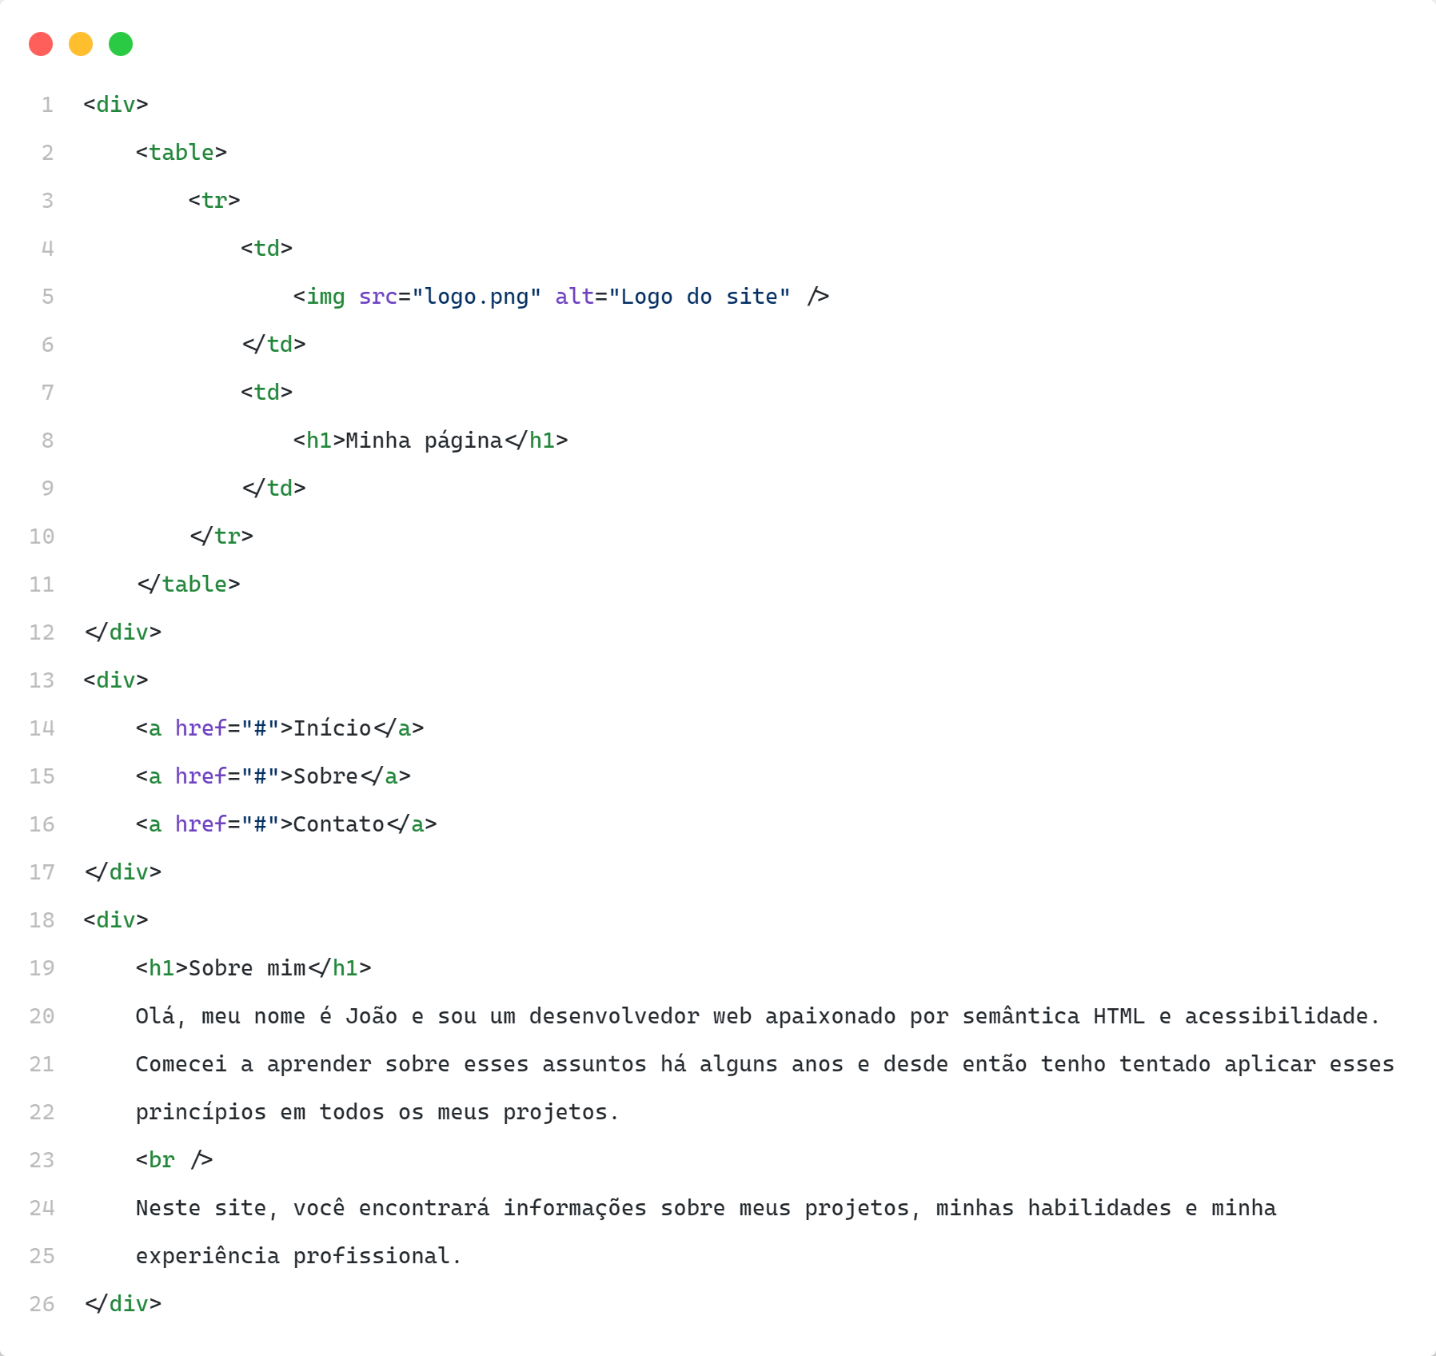
Exemplo Ruim

Slide 7
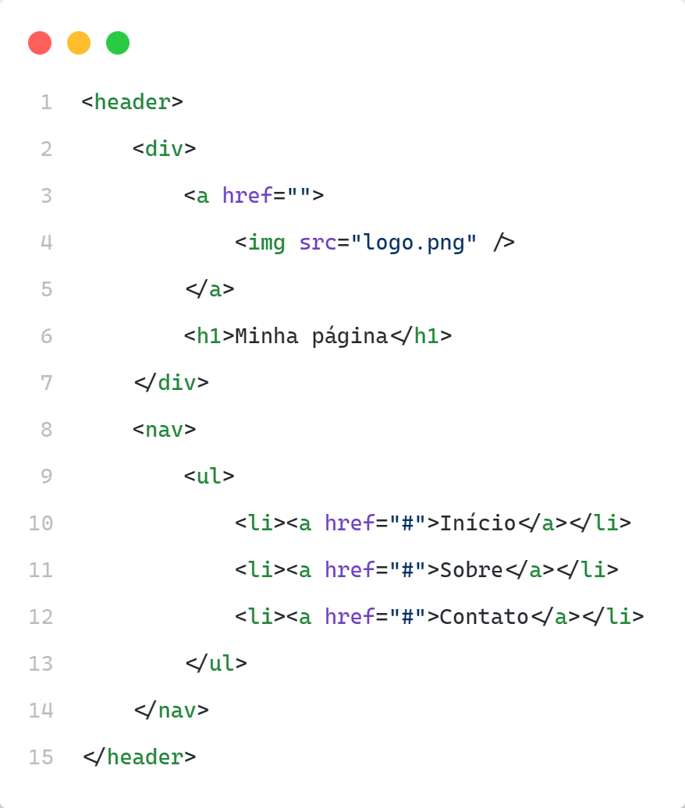
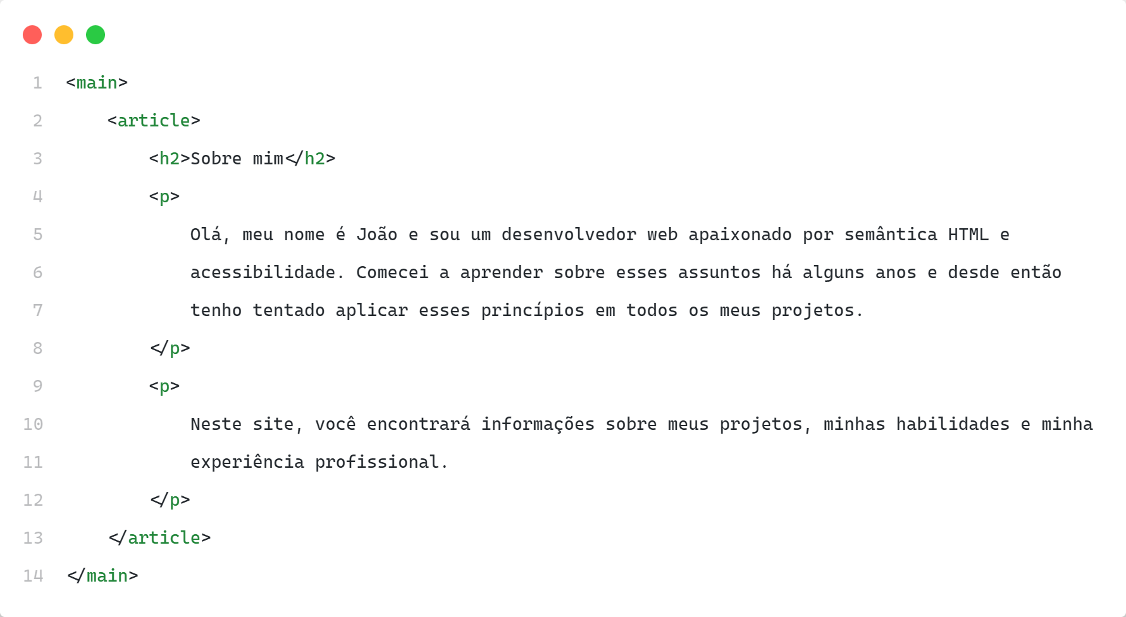
Correção

Slide 8




Motivos para se ter
Acessibilidade
SEO
Leitor de tela, deficiências, baixa visão, problemas motores, etc
Desempenho de busca, do que se trata sua página, visibilidade nas pesquisas
UX
Lei nº 13.146/2015
Navegação, entender o conteúdo, encontrar o que procura, etc.
Deve ser acessível para pessoas com deficiência visual, auditiva, física e intelectual

Slide 9
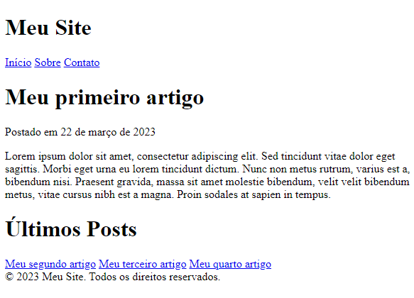
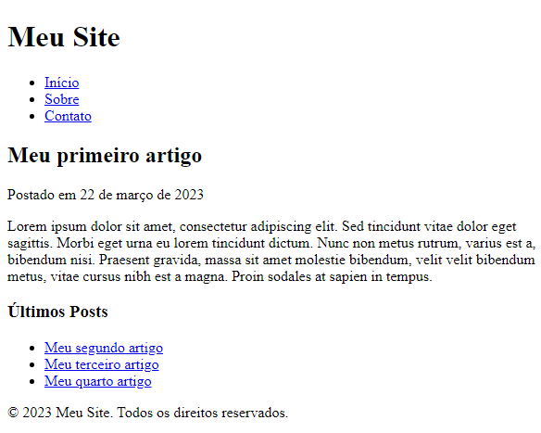
Experiência de usuário

Slide 10
WAI-ARIA
ERIKA

Slide 11
Digital Divide Infographics
Area with worst signal
Signal
Area with best signal
Mercury is the smallest planet in the Solar System
Earth is the third planet and is where we all live on
Despite being red, Mars is actually a cold place

Slide 12
Digital Divide Infographics
Differences in bandwidth
Saturn
Earth
Mars
Jupiter
50%
75%
90%
100%
Saturn is a gas giant and has several rings
Earth is the third planet and is where we all live on
Despite being red, Mars is actually a cold place
Jupiter is the biggest planet in the Solar System

Slide 13
Digital Divide Infographics
35%
45%
Jupiter
Venus
Jupiter is the biggest planet of them all
Venus is the second planet from the Sun
55%
60%
Earth
Mars
Earth is the third planet and is where we all live on
Despite being red, Mars is actually a cold place

Slide 14
Digital Divide Infographics
Percentage of people who don’t have access to a mobile network
Despite being red, Mars is actually a cold place
25-30%
Saturn is a gas giant and has several rings
20-25%
Mercury is the smallest planet in the Solar System
15-20%
Jupiter is the biggest planet in the Solar System
10-15%

Slide 15
Digital Divide Infographics
Differences between having access to WiFi or not
Venus
Mercury
1
1
Venus is terribly hot, even hotter than Mercury
Mercury is the smallest planet in the Solar System
Mars
Saturn
2
2
Despite being red, Mars is actually a cold place
Saturn is a gas giant and has several rings
Earth
Jupiter
3
3
Earth is the third planet and is where we all live on
Jupiter is the biggest planet in the Solar System

Slide 16
Digital Divide Infographics
Access to new technologies according to economic income
95%
55%
High income
Low income
Jupiter is the biggest one
It has a beautiful name
Earth is the third planet
Mars is a cold place
Venus is terribly hot
It’s full of iron oxide dust
Saturn is a gas giant
It’s the seventh planet

Slide 17
Digital Divide Infographics
1 | 2 | 3 | 4
Mercury | Saturn | Jupiter | Mars
Mercury is the smallest planet in the Solar System | Saturn is a gas giant and has several rings | Jupiter is the biggest planet in the Solar System | Despite being red, Mars is actually a cold place

Slide 18
Digital Divide Infographics
Mercury
Saturn
Earth
Venus
Mercury is the smallest planet in the Solar System
Saturn is composed mostly of hydrogen and helium
Earth is the only planet that harbors life in the Solar System
It has a beautiful name and is the second planet from the Sun

Slide 19
Digital Divide Infographics
Digital divide with disabled people
Able-bodied
Disabled
Jupiter is the fifth planet from the Sun and the biggest of them all
Earth is the third planet from the Sun and the only one that harbors life
It’s a cold place full of iron oxide dust, which gives the planet its reddish cast
It’s the closest planet to the Sun and the smallest one in the Solar System
Saturn was named after the Roman god of wealth and agriculture
It’s the second one from the Sun. It’s terribly hot, even hotter than Mercury

Slide 20
Digital Divide Infographics
Neptune
Saturn
Mercury
Mars
Neptune is the farthest planet from the Sun
Saturn is a gas giant and it has several rings
Mercury is the smallest planet in the Solar System
Despite being red, Mars is a cold place

Slide 21
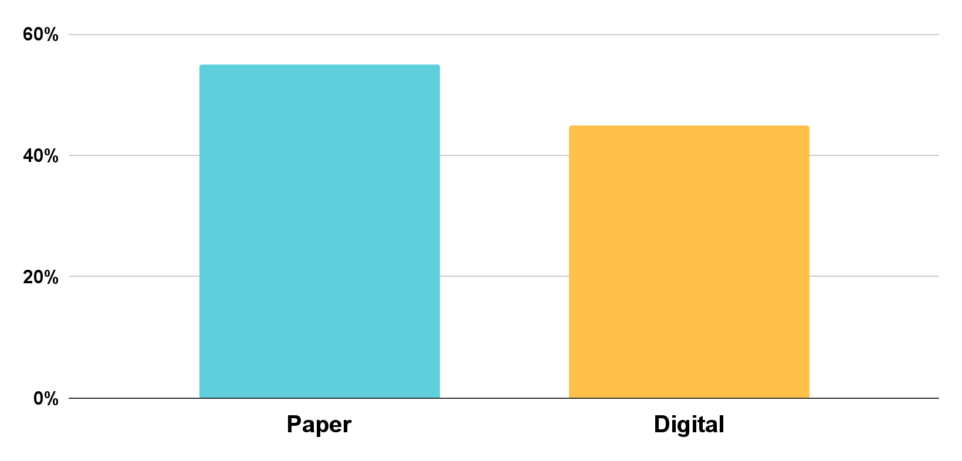
Digital Divide Infographics
Paper education VS digital education
55%
45%
2021
Paper education
Digital education
Mercury is the smallest planet of them all
Despite being red, Mars is actually a cold place
Follow the link in the graph to modify its data and then paste the new one here. For more info, click here

Slide 22
Digital Divide Infographics
Young people
Old people
Jupiter is the biggest planet in the Solar System
23%
77%
Venus is the second planet from the Sun
Able-bodied
Disabled
Mercury is the smallest planet in the Solar System
60%
40%
Saturn is a gas giant and has several rings
Wealthy
Poor
Despite being red, Mars is actually a cold place
85%
15%
Earth is the third planet and is where we all live on

Slide 23
Digital Divide Infographics
WiFi connection in differents areas
Countryside
City
Mountains
Jupiter is the biggest one
It’s actually a cold place
Saturn is a gas giant
Venus is terribly hot
It has a beautiful name
It’s full of iron oxide dust
Earth is the third planet
It’s the seventh planet
It’s the closest planet
Jupiter is a gas giant
It has several rings
It’s the fifth planet

Slide 24
Digital Divide Infographics
People without WiFi
People with WiFi
35%
65%
It has a beautiful name and is the second planet from the Sun
Mercury is the closest planet to the Sun and the smallest one

Slide 25
Digital Divide Infographics
Evolution of the digital divide in each country
 | North America | South America | Europe | Asia | Africa | Australia
2018 | 25% | 45% | 28% | 35% | 65% | 24%
2019 | 23% | 43% | 25% | 32% | 60% | 24%
2020 | 23% | 40% | 24% | 28% | 58% | 22%
2021 | 21% | 37% | 22% | 27% | 55% | 21%
% People who don’t have access to communications technology

Slide 26
Digital Divide Infographics
1
2
3
4
5
Earth
Mercury
Jupiter
Venus
Mars
Earth is the third planet from the Sun and the only one that harbors life
Mercury is the closest planet to the Sun and the smallest one
Jupiter is a gas giant and the biggest planet in the Solar System
Venus has a beautiful name and is the second planet from the Sun
Despite being red, Mars is actually a cold place full of iron oxide dust

Slide 27
Digital Divide Infographics
Venus
01
Venus has a beautiful name and is the second planet from the Sun
Mars
02
Despite being red, Mars is actually a cold place full of iron oxide dust
Jupiter
03
Jupiter is a gas giant and the biggest planet in the Solar System
Earth
04
Earth is the only planet that harbors life in the Solar System

Slide 28
Digital Divide Infographics
Countries with highest internet speed
Countries with lowest internet speed
New York
Cape Town
It’s actually a cold place
It has a beautiful name
Sydney
Santiago
Earth is the third planet
Saturn has several rings
Shanghai
Istanbul
It’s the smallest planet
It’s the biggest planet

Slide 29
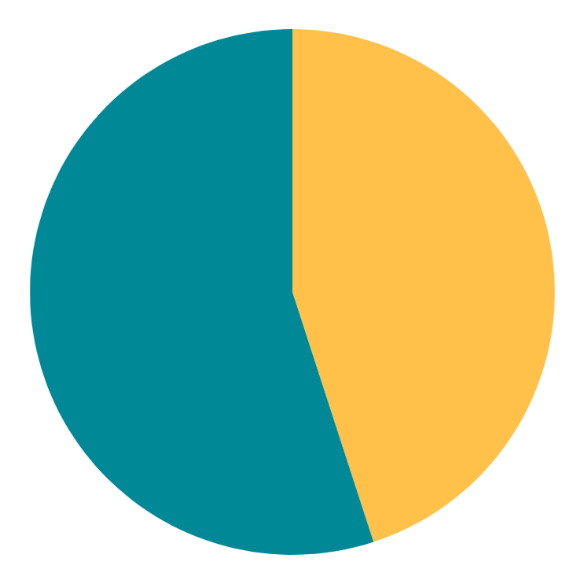
Digital Divide Infographics
Digital divide between men and women
55%
45%
Men
Women
Follow the link in the graph to modify its data and then paste the new one here. For more info, click here
Mercury is the closest planet to the Sun
Despite being red, Mars is actually a cold place

Slide 30
Digital Divide Infographics
1
2
1
Venus
Saturn
Venus is the second planet from the Sun
Saturn is a gas giant and has several rings
2
4
3
3
4
Mars
Earth
Despite being red, Mars is actually a cold place
Earth is the third planet and is where we live on

Slide 31
Digital Divide Infographics
Digital possibilities in the different phases
45%
90%
Child
Adult
Saturn is a gas giant and has several rings
Earth is the third planet and is where we all live on
95%
30%
Teen
Senior Adult
Jupiter is the biggest planet in the Solar System
Despite being red, Mars is actually a cold place

Slide 32
Digital Divide Infographics
Digital differences between living in a farm or in a city
Saturn is a gas giant and has several rings
Despite being red, it’s actually a cold place
It’s the third planet in the Solar System
It’s the farthest planet from the Sun
It’s the smallest planet in the Solar System
It’s the biggest planet in the Solar System
It’s terribly hot, even hotter than Mercury
It’s the planet where we all live on

Slide 33
Digital Divide Infographics
Traditional education VS digital education
Traditional education | Digital education
Jupiter is the biggest planet | Uranus is the seventh planet
It’s a gas giant and has several rings | Neptune is the farthest planet
Venus has a beautiful name | Mars is actually a cold place
It's the planet where we live on | Mercury is the smallest planet

Slide 34
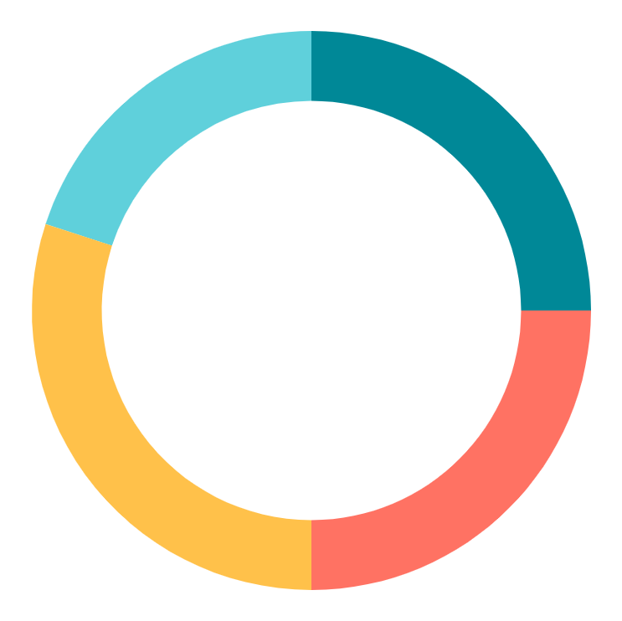
Digital Divide Infographics
Why people have difficulty connecting to the Internet
Venus
Mars
20%
25%
Venus has a beautiful name and is the second planet from the Sun
Despite being red, Mars is actually a cold place full of iron oxide dust
Mercury
Jupiter
Mercury is the closest planet to the Sun and the smallest one
30%
25%
Jupiter is a gas giant and the biggest planet in the Solar System
Follow the link in the graph to modify its data and then paste the new one here. For more info, click here

Slide 35
Digital Divide Infographics
The difficulty to be connected in the mountains
Mercury
Jupiter
Earth
Mercury is the closest planet to the Sun and the smallest one
It’s a gas giant and the biggest planet in the Solar System
Earth is the only planet that harbors life in the Solar System
1
2
3

Slide 36
Digital Divide Infographics
Access to mobile phone in differents ages
21-30
31-40
41-50
51-60
61+
11-20
0-10
Earth
Saturn
Mercury
Venus
Jupiter
Pluto
Uranus
Earth is the planet where we all live on
It is a gas giant and has several rings
Mercury is the closest planet to the Sun
It’s terribly hot, even hotter than Mercury
It’s the biggest planet in the Solar System
Pluto is now considered a dwarf planet
Uranus is the seventh planet from the sun

Slide 37
Instructions for use
In order to use this template, you must credit Slidesgo in your final presentation.
You are allowed to:
- Modify this template.
- Use it for both personal and commercial projects.
You are not allowed to:
- Sublicense, sell or rent any of Slidesgo Content (or a modified version of Slidesgo Content).
- Distribute Slidesgo Content unless it has been expressly authorized by Slidesgo.
- Include Slidesgo Content in an online or offline database or file.
- Offer Slidesgo templates (or modified versions of Slidesgo templates) for download.
- Acquire the copyright of Slidesgo Content.
For more information about editing slides, please read our FAQs or visit Slidesgo School:
https://slidesgo.com/faqs and https://slidesgo.com/slidesgo-school

Slide 38
Instructions for use (premium users)
In order to use this template, you must be a Premium user on Slidesgo.
You are allowed to:
Modify this template.
Use it for both personal and commercial purposes.
Hide or delete the “Thanks” slide and the mention to Slidesgo in the credits.
Share this template in an editable format with people who are not part of your team.
You are not allowed to:
Sublicense, sell or rent this Slidesgo Template (or a modified version of this Slidesgo Template).
Distribute this Slidesgo Template (or a modified version of this Slidesgo Template) or include it in a database or in any other product or service that offers downloadable images, icons or presentations that may be subject to distribution or resale.
Use any of the elements that are part of this Slidesgo Template in an isolated and separated way from this Template.
Register any of the elements that are part of this template as a trademark or logo, or register it as a work in an intellectual property registry or similar.
For more information about editing slides, please read our FAQs or visit Slidesgo School:
https://slidesgo.com/faqs and https://slidesgo.com/slidesgo-school

Slide 39
Infographics
You can add and edit some infographics to your presentation to present your data in a visual way.
Choose your favourite infographic and insert it in your presentation using Ctrl C + Ctrl V or Cmd C + Cmd V in Mac.
Select one of the parts and ungroup it by right-clicking and choosing “Ungroup”.
Change the color by clicking on the paint bucket.
Then resize the element by clicking and dragging one of the square-shaped points of its bounding box (the cursor should look like a double-headed arrow). Remember to hold Shift while dragging to keep the proportions.
Group the elements again by selecting them, right-clicking and choosing “Group”.
Repeat the steps above with the other parts and when you’re done editing, copy the end result and paste it into your presentation.
Remember to choose the “Keep source formatting” option so that it keeps the design. For more info, please visit Slidesgo School.

